Slide 1



Automatic Waste Management and Segregation System using IoT
PRESENTED BY:
190040287
190040170
190040564

Slide 2
ABSTRACT
Waste Management and segregation is a much-needed process in metro cities and urban areas due to spreading of diseases.
This system is developed to overcome the challenges, barriers and to provide an opportunity for improvements in waste management and segregation system. The Automatic waste management and segregation system use the concept of IoT, where the proposed system is placed all over the cities, with an embedded system to segregate and monitor the level of the bin. The status of bins is sent to concerned authorities to evacuate the bins and the locations of bins are traced via the internet. This system reduces human intervention, interaction and also reduces the consumption of time and cost.
Waste lying littered in the surrounding, dumped on open lands, becomes a major problem for various types of disease-causing bacteria and viruses hence, segregation, transport, handling and disposal of waste must be managed properly to minimize the risks of the public and environment. When mixed dry and wet waste breaks down in lowland, it creates nasty greenhouse gases. Segregation makes it attainable to utilize and recycle the waste effectively.

Slide 3
INTRODUCTION
In the current situation, India is facing various challenges in the environment by the waste generated such as improper waste collection, treatment, transport, disposal. The most difficult challenge is from its inception to its disposal. Due to the increasing urban population, our country cannot survive the current system which results in environmental and public health pollution. Waste can be solid or liquid and each type of waste will have different methods of disposal. Waste will be a threat to human health. Proper management of waste is necessary and important to have a healthy lifestyle. An unhygienic environment will be created if flooding of the dustbins happens every day. Waste segregation i.e., separation of dry and wet waste is also important. Segregation of waste helps in the reduction of the amount of waste that gets landfilled and also reduces air and water pollution. If we segregate the waste, it is easy to dispose of compared to mixed waste. .
Segregation of waste helps in the reduction of the amount of waste that gets landfilled and also reduces air and water pollution. If we segregate the waste, it is easy to dispose of compared to mixed waste.

Slide 4
COMPONENTS USED
ARDUINO UNO
NODEMCU(ESP8266)
DRY WET SENSOR
IR SENSOR
MQ SENSOR
BIN

Slide 5
ARDUINO UNO: The Arduino Uno is an open-source microcontroller. The board is provided with digital and analog I/O pin sets. It contains fourteen digital I/O pins in which 6 of PWM output, Six analog I/O pins, and is programmable with the Arduino Uno. It might be turned on with the help of a USB cable or with help of external 9 volt battery, it can accept voltage from 7 to 20 volt.
NODEMCU(ESP8266): NodeMCU is an integrated chip that provides full internet connectivity to the embedded circuit in which it is present. It is mapped through the USB port using Arduino IDE. It contains 30 pins of which 9 pins are digital pins while 1 pin is an analog pin. It is a tool that works on Wi-Fi networking. It has low power consumption.
SERVO MOTOR:A servomotor is an electric motor. It is controlled with the help of servomechanism. A servo motor is an electrical device, that spins the parts of a machine with high efficiency and with great precision. In our project servo motor moves both bidirectional clockwise and anticlockwise at an appropriate angle to dispose of the trash at a particular place.

Slide 6
DRY WET SENSOR: The moisture sensor has been used to detect the type of waste being placed on it. Here the sensor classifies the waste into dry and wet based on the moisture content on it.; if the moisture content is above a preset threshold value, then the waste is declared as wet waste else it is declared as dry waste.
MQ SENSOR:The MQ sensor gas sensor is a highly sensitive sensor used to detect gases like ammonia, smoke, sulphur, and other harmful gases. It used to detect toxic substance and explosive gasses and measure gas concentration. Here it is used to detect the odour of waste and sends an SMS to municipal department if there is strong concentration of odour. Hence helps to have good environmental condition.
INFRARED SENSOR:An infrared sensor emits to sense the surroundings. It is used to detect the amount of waste in each dustbin. Thus, it helps in preventing overflow of bins.

Slide 7
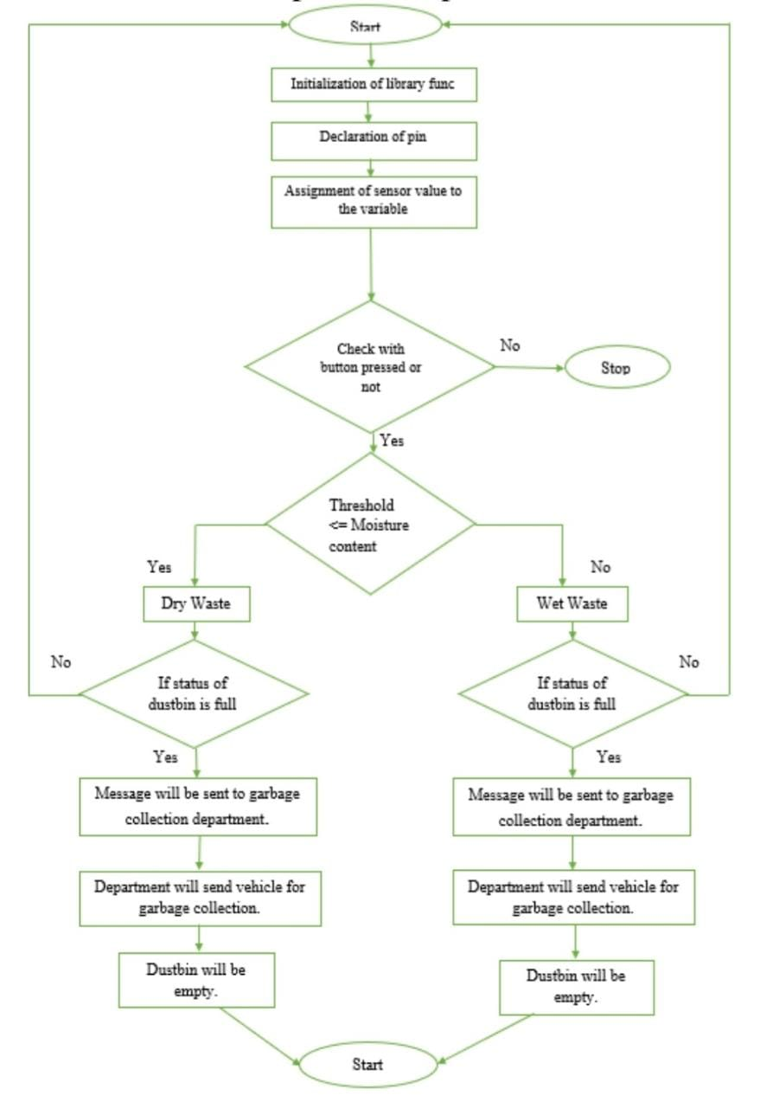
FLOW CHART:

Slide 8
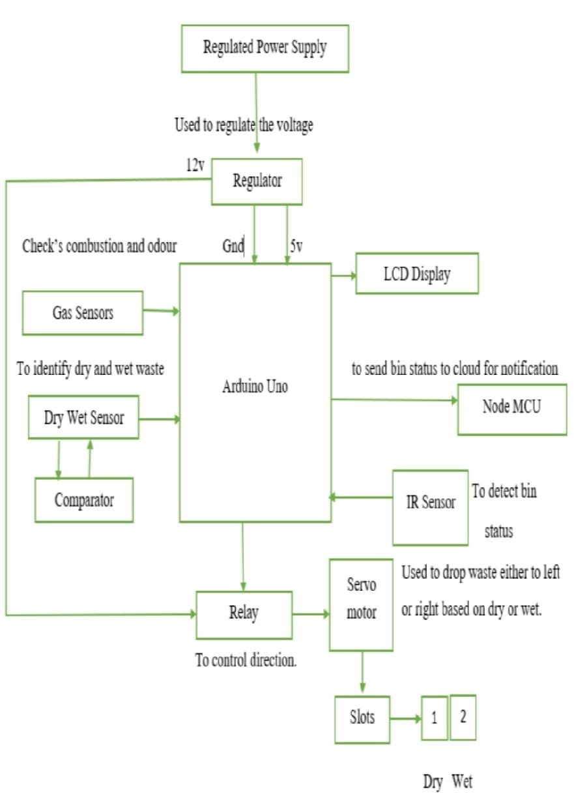
BLOCK DIAGRAM

Slide 9
CONCLUSION:
This project can be used in our day-to-day life, which will be able to segregate the dry and wet waste. • This system monitors the status of the bin and intimates it to the municipality.
• It avoids overflow of bins which in turn reduces the environmental pollution and hazards to human health.
• It enables the wireless transmission of data and its data can be accessed anywhere at any time. The proposed system can be implemented everywhere in the cities and also in urban areas to which pollution free and creates an environmentfriendly atmosphere which helps to lead healthy, hazardous free life. It saves the life of the people without causing hazards to life by avoiding the overflow of bins

